Slide 1
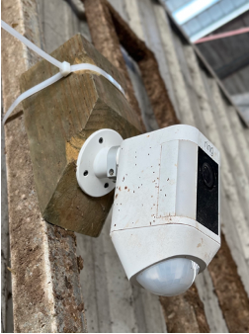
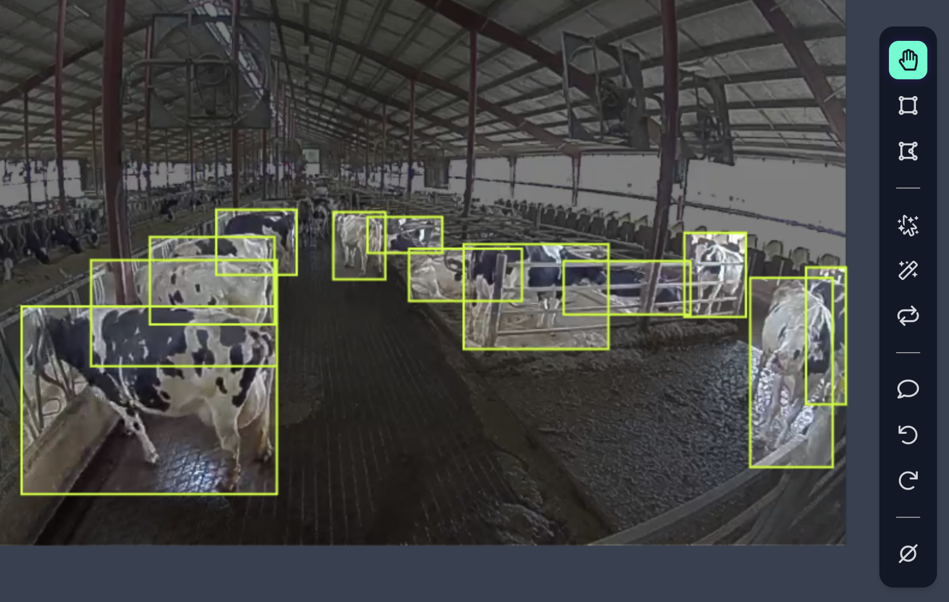



Data Collection Pipeline
Camera Deployment
Call Ring API to fetch images/videos
Image Annotation
The IoT system allows data access through phones, webpages, and customized APIs, but requires Wi-Fi and has a battery life of less than a month.

Slide 2
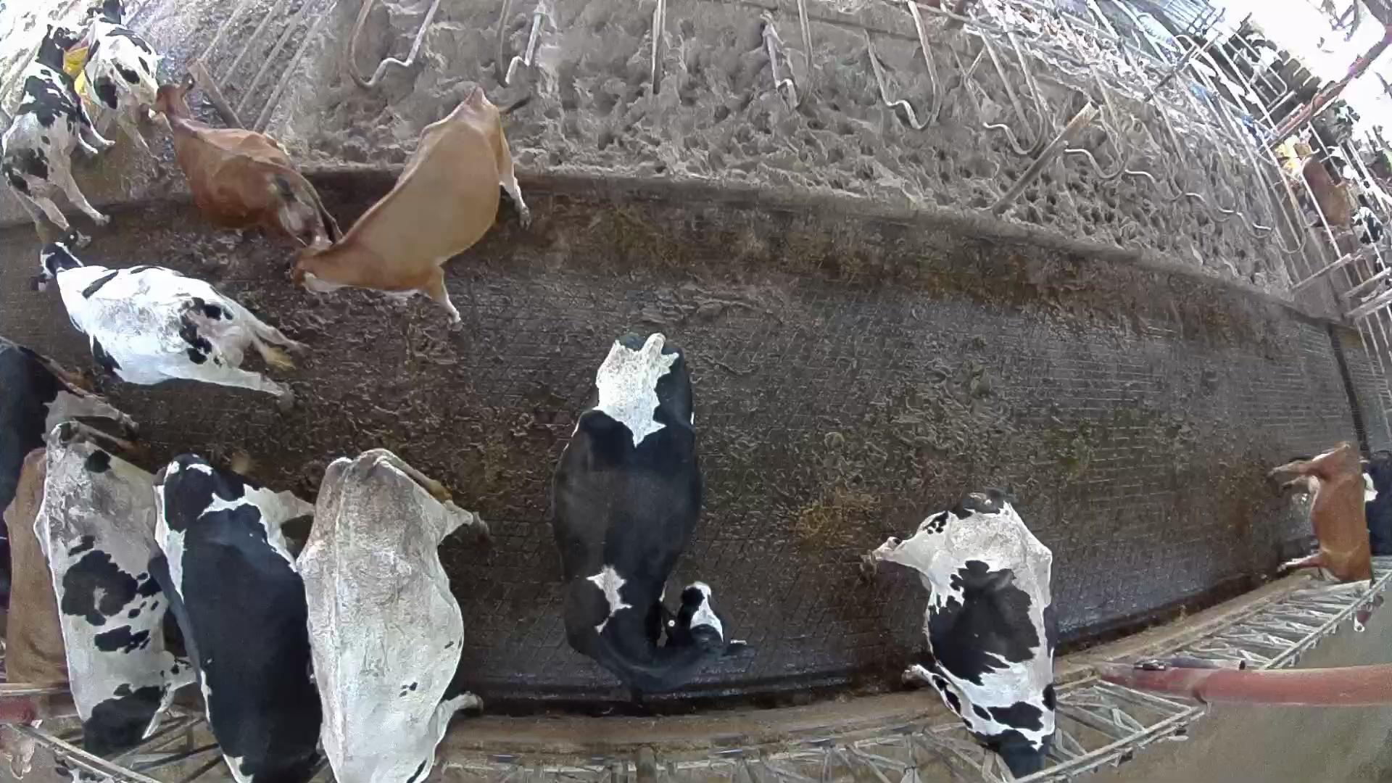
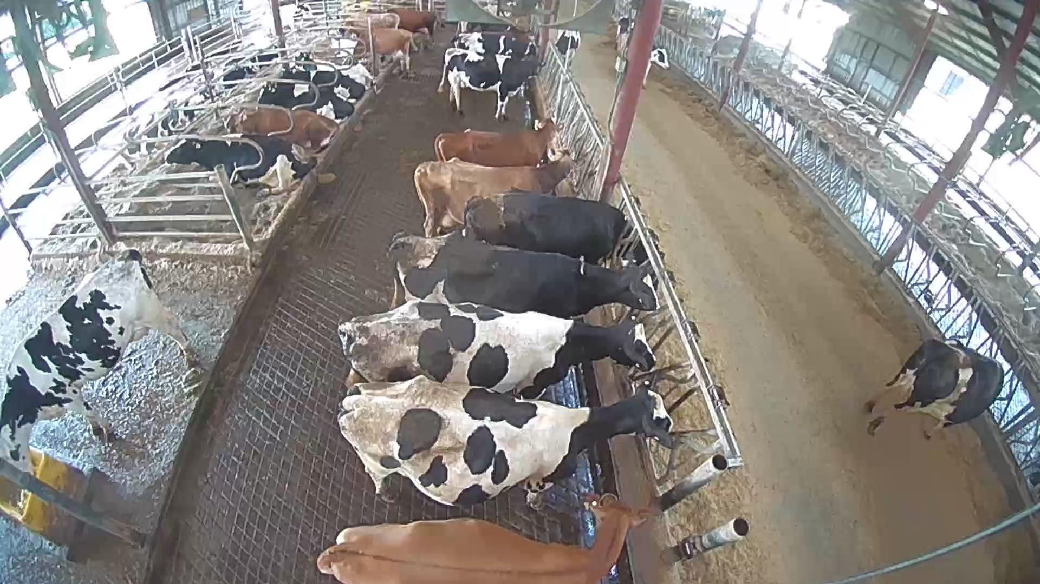
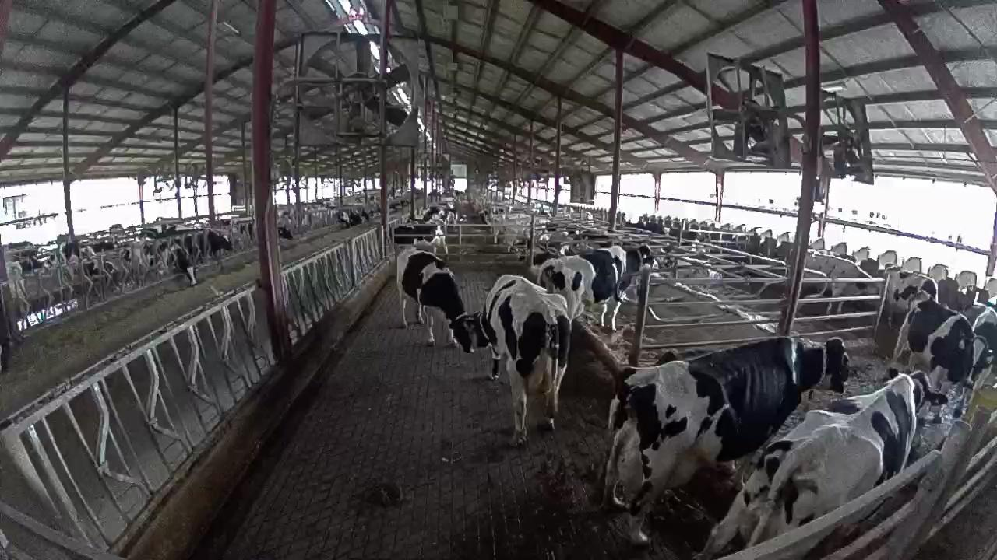
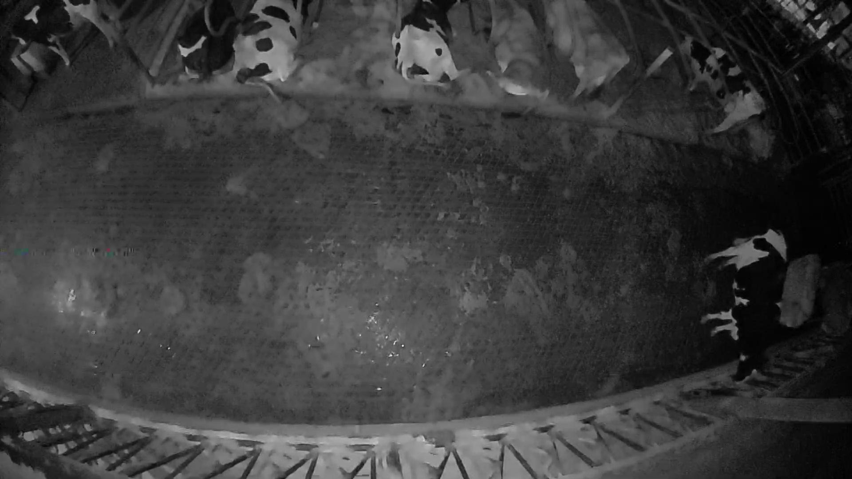
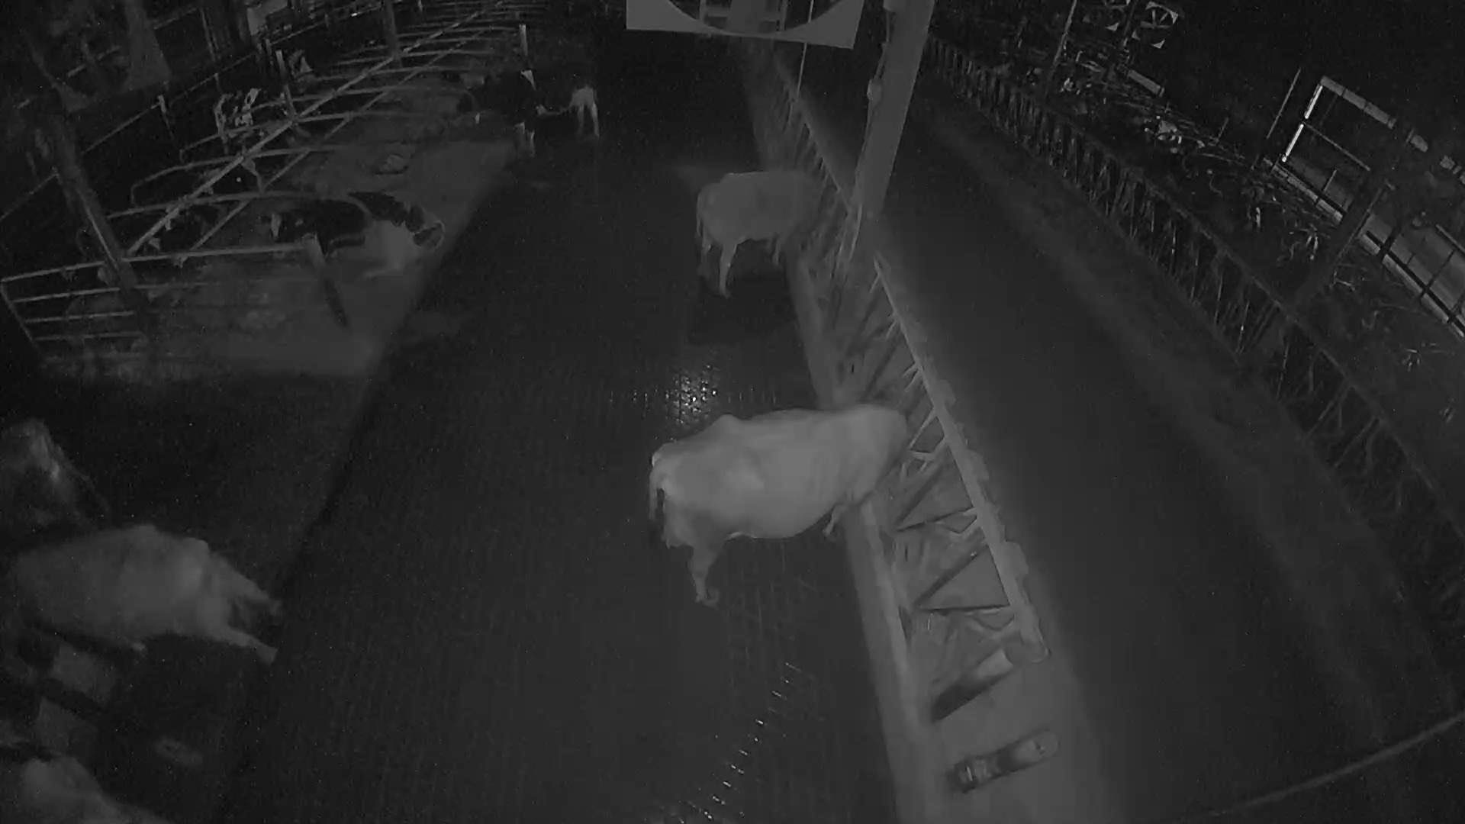
Data Management
Monitoring angle
External 1 (US)
External 2 (TW)
Top view
60-degree sideview
This Collection
Daylight
Lighting Condition
Lower angle
Indoor light / NIR
All Holstein cows

Slide 3
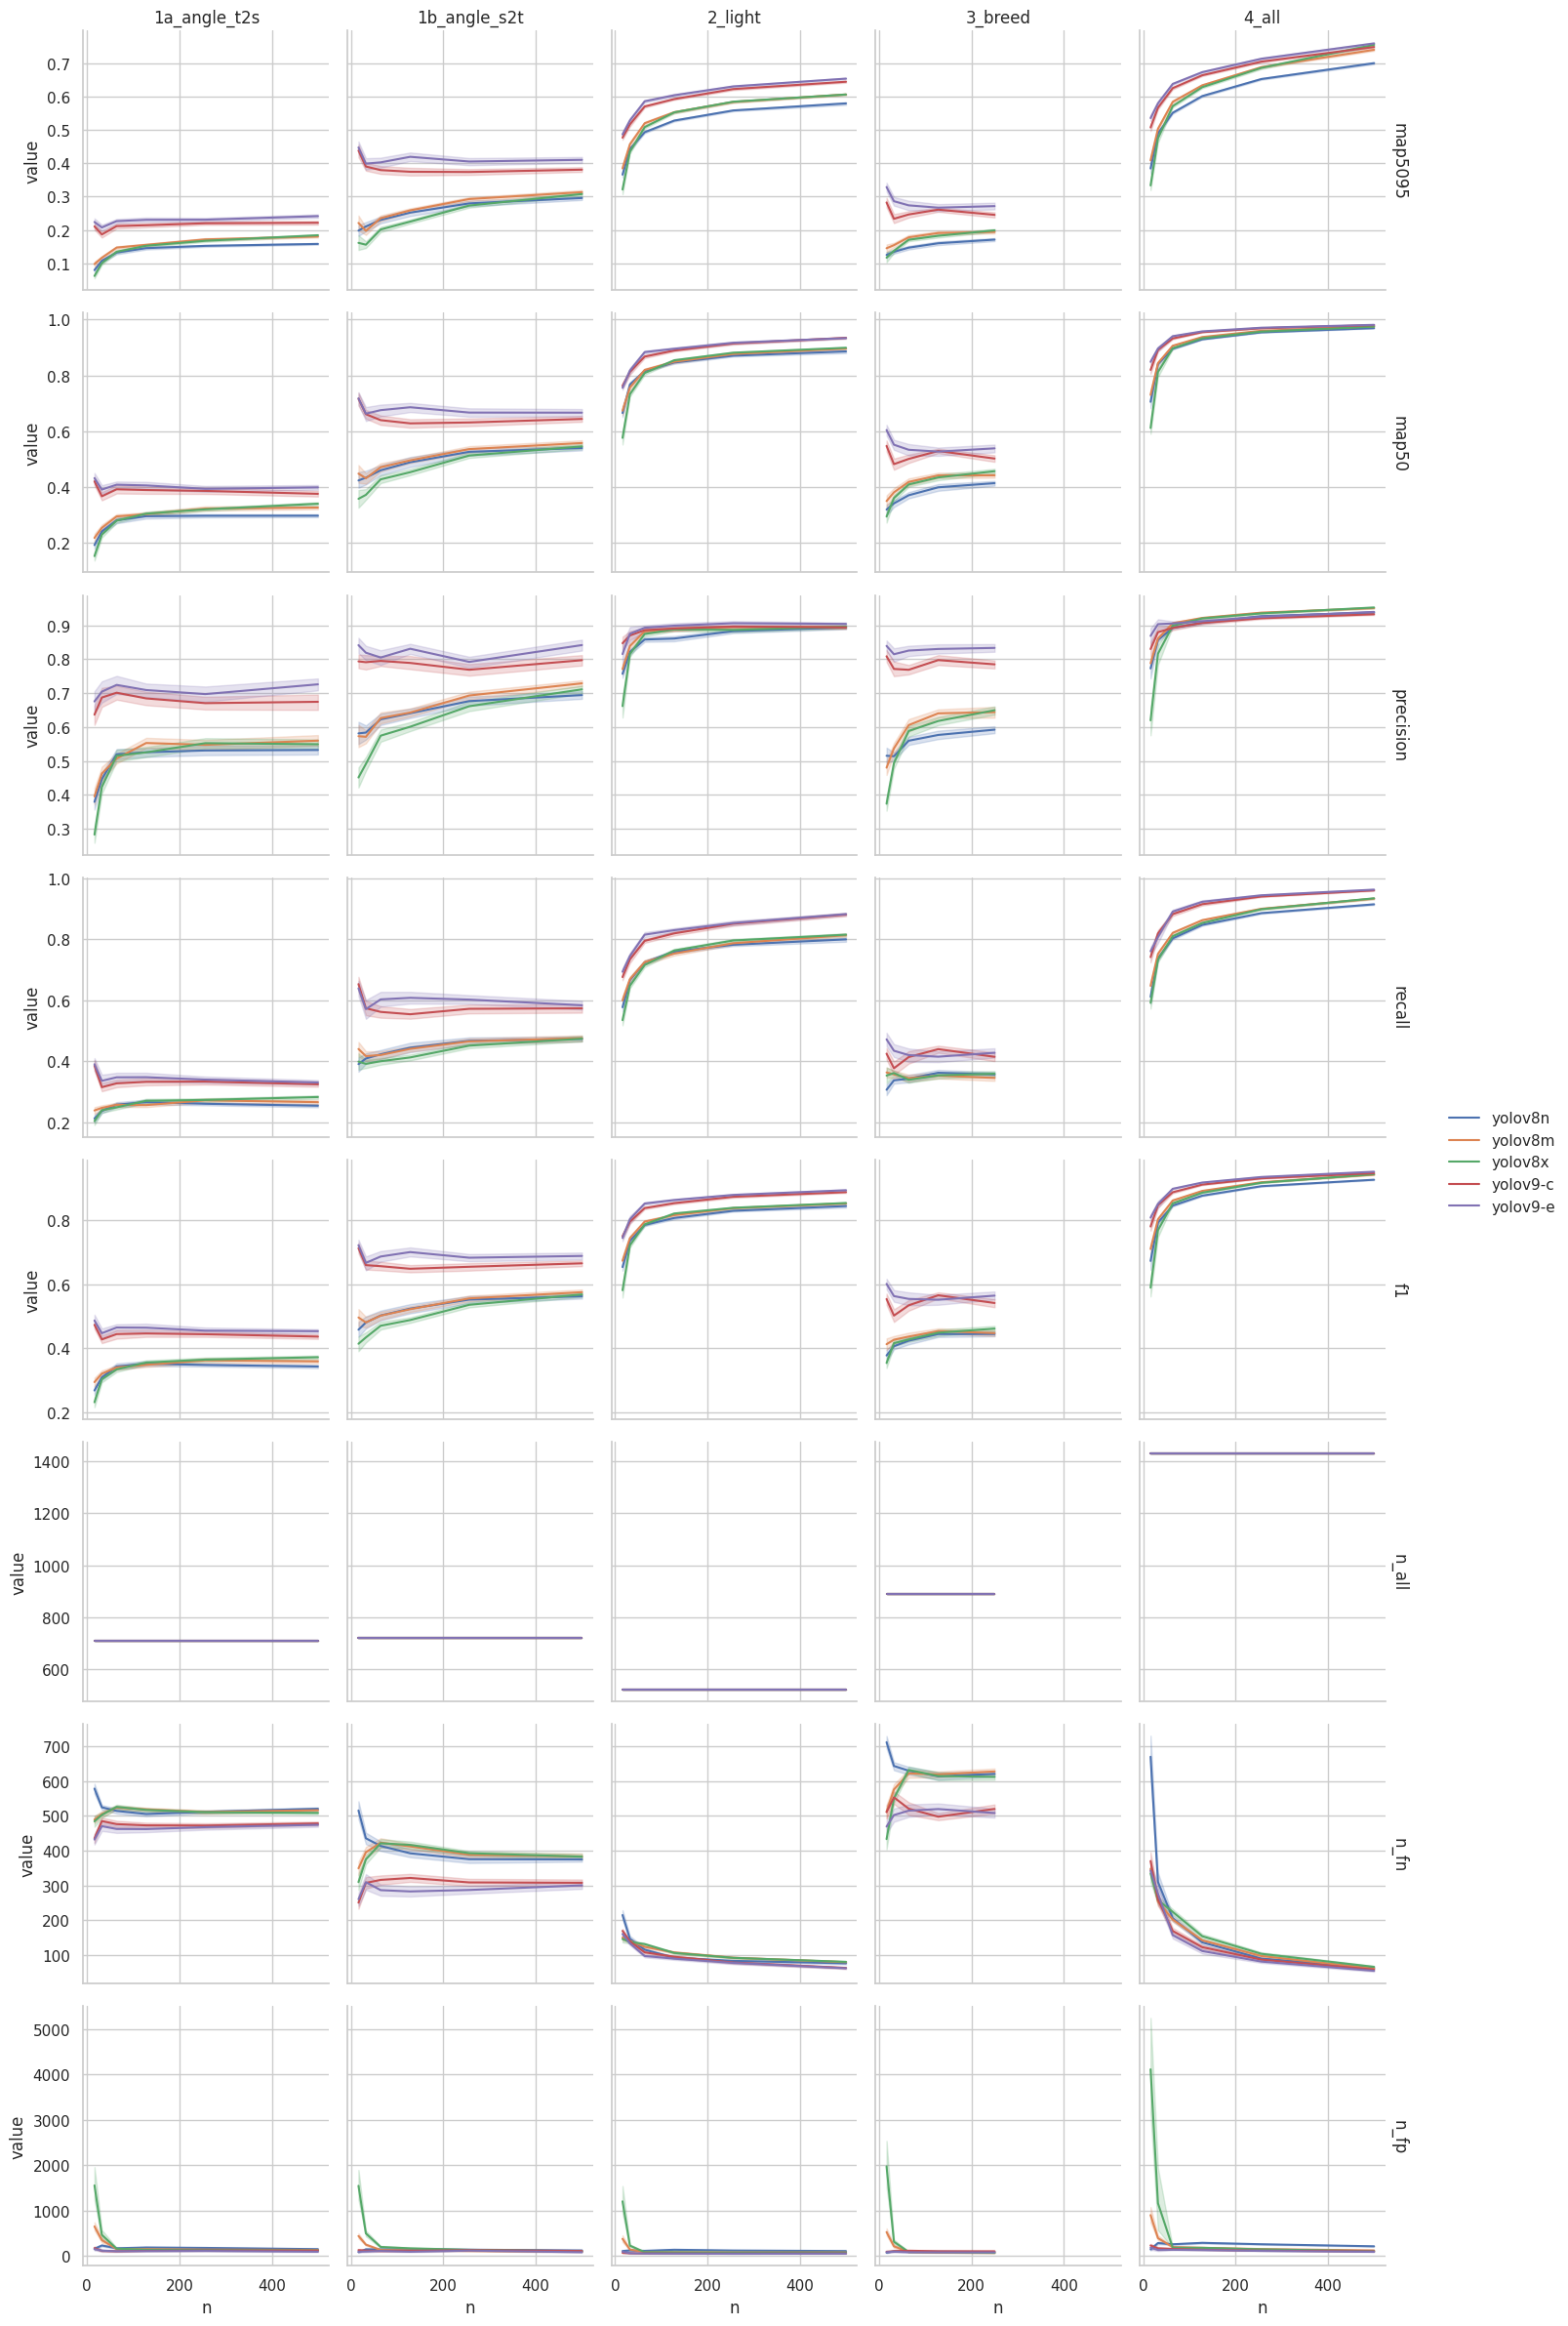
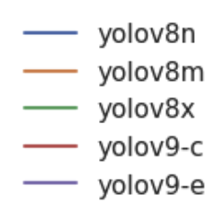
Study from Chen Lab
Chen Lab is interested in studying the model's ability to generalize across different fields and farms. The study output includes an open-access dataset in YOLO and COCO formats as well as fine-tuned model weights in PyTorch checkpoint format.
Performance across Different Datasets (column-faceted)
Training sample size

